Slide 1

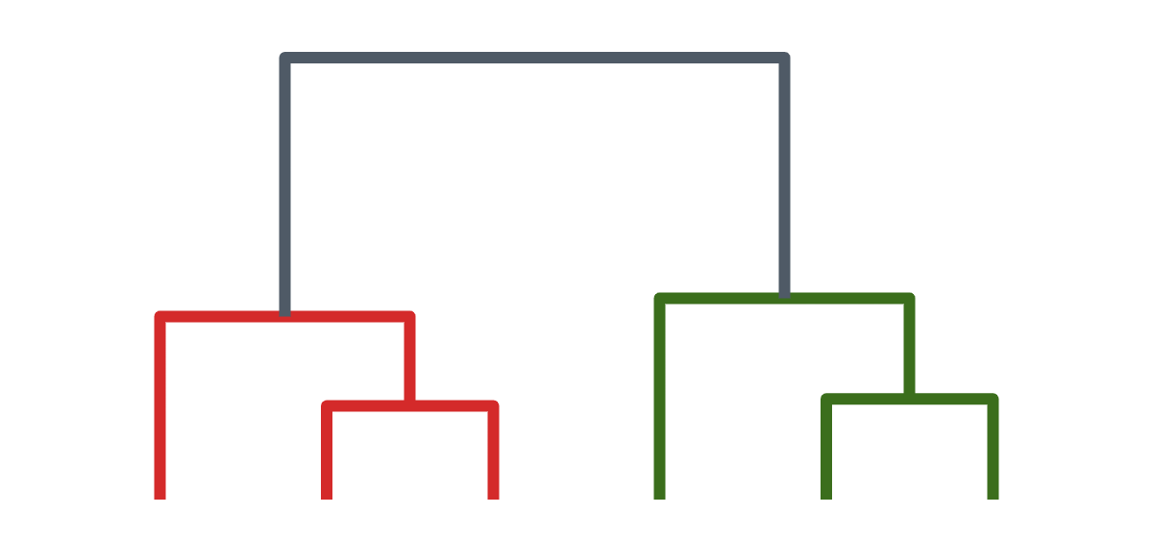
Hierarchical Clustering
Bottom-up (agglomerative) · Top-down (recursive k-means)
[Presenter name] · [Course] · [Date]
Notes:
Welcome. Last time we covered partitioning methods: k-means, k-means++ and k-medoids. Today: hierarchical clustering, which builds a whole tree of clusters, in two directions: bottom-up by merging and top-down by splitting.

Slide 2
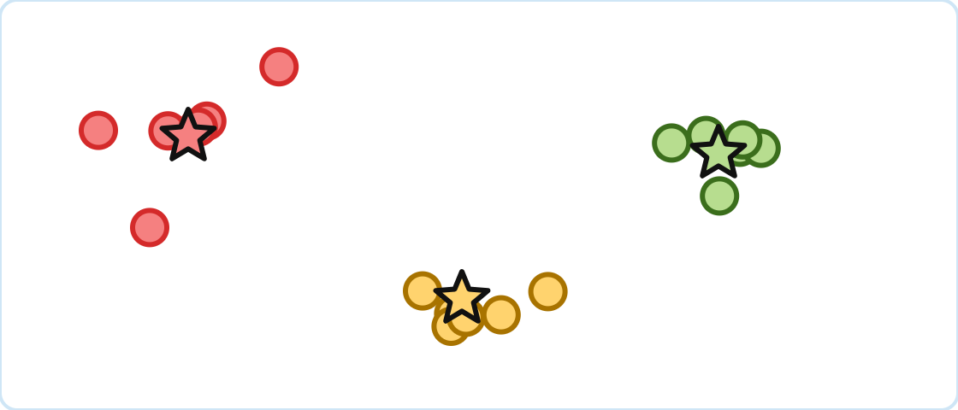
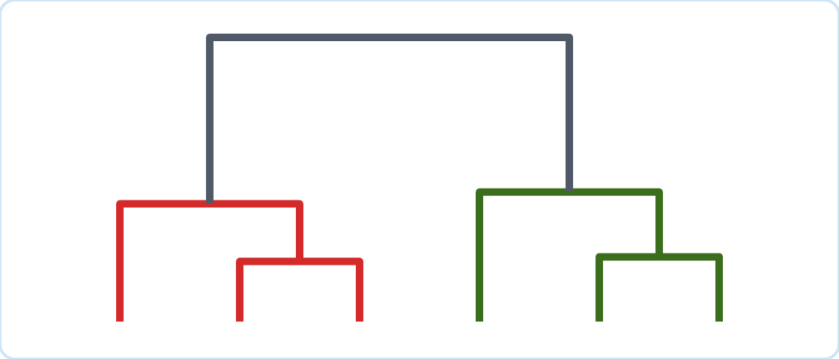
From Flat to Nested Clusters
Partitioning gives one level; hierarchical clustering gives all levels
Partitioning
Hierarchical
One flat set of k clusters
k is chosen before running
k-means, k-means++, k-medoids
A tree of nested clusters
Choose the level afterwards
Agglomerative, divisive
Notes:
Quick recap. Partitioning methods give you exactly one answer for one chosen k. Hierarchical methods give you every level at once: 1 cluster, 2 clusters, and so on up to n, nested inside each other. You decide later which level to use.

Slide 3
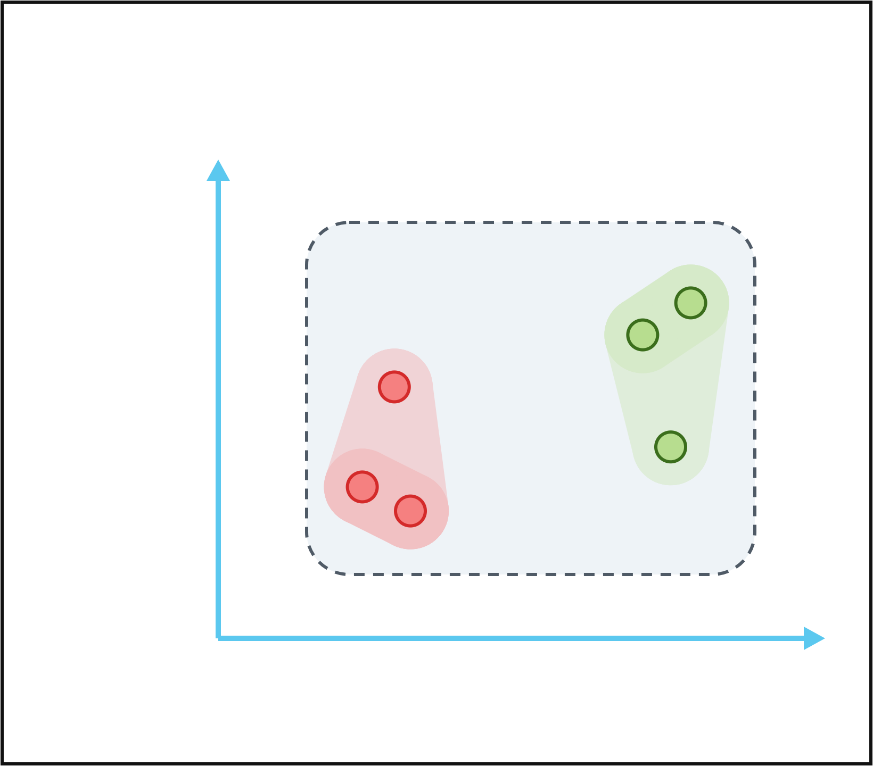
What Is Hierarchical Clustering?
Clusters inside clusters, organised as a tree
Hierarchy
A tree of nested clusters, from single objects up to one cluster holding everything.
E
Dendrogram
D
C
The tree diagram that records the order and distance of every merge or split.
Minutes of Exercise
F
A
B
No k up front
Pick the number of clusters afterwards by cutting the tree.
Hours of Sleep
Notes:
Look at the nesting: A and B form a tight pair; together with C they form a larger group. Likewise D and E, then F. Hierarchical clustering captures all of these levels in one structure.

Slide 4
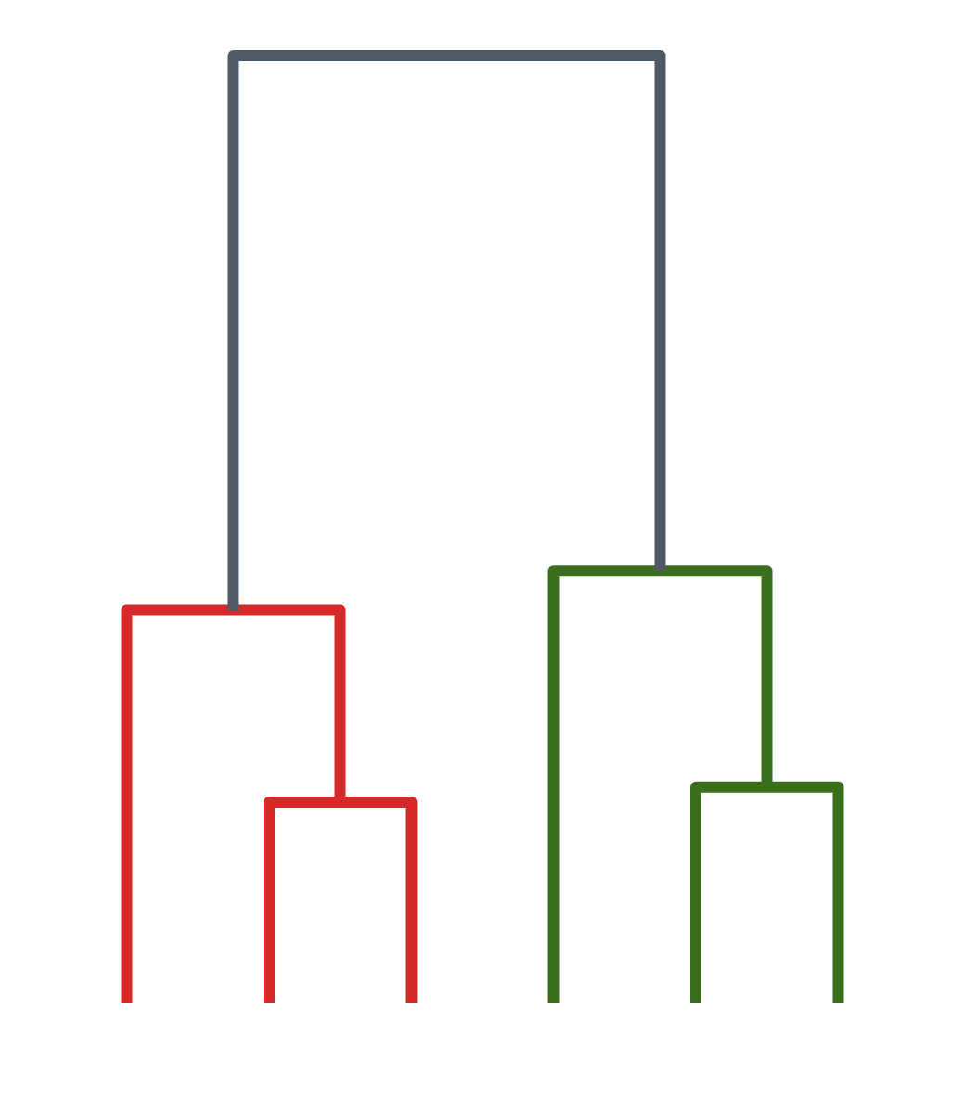


Two Ways to Build the Tree
Merge from the bottom, or split from the top
Bottom-up
Agglomerative
Top-down
Divisive
Start with 6 single points. Merge the two closest clusters, again and again.
Start with 1 cluster of everything. Split a cluster in two, again and again.
C
A
B
F
D
E
Notes:
The same kind of tree can be built in two directions. Bottom-up, called agglomerative, starts at the leaves and merges. Top-down, called divisive, starts at the root and splits. In this lecture we use the agglomerative algorithm for bottom-up and recursive k-means, also called bisecting k-means, for top-down.

Slide 5
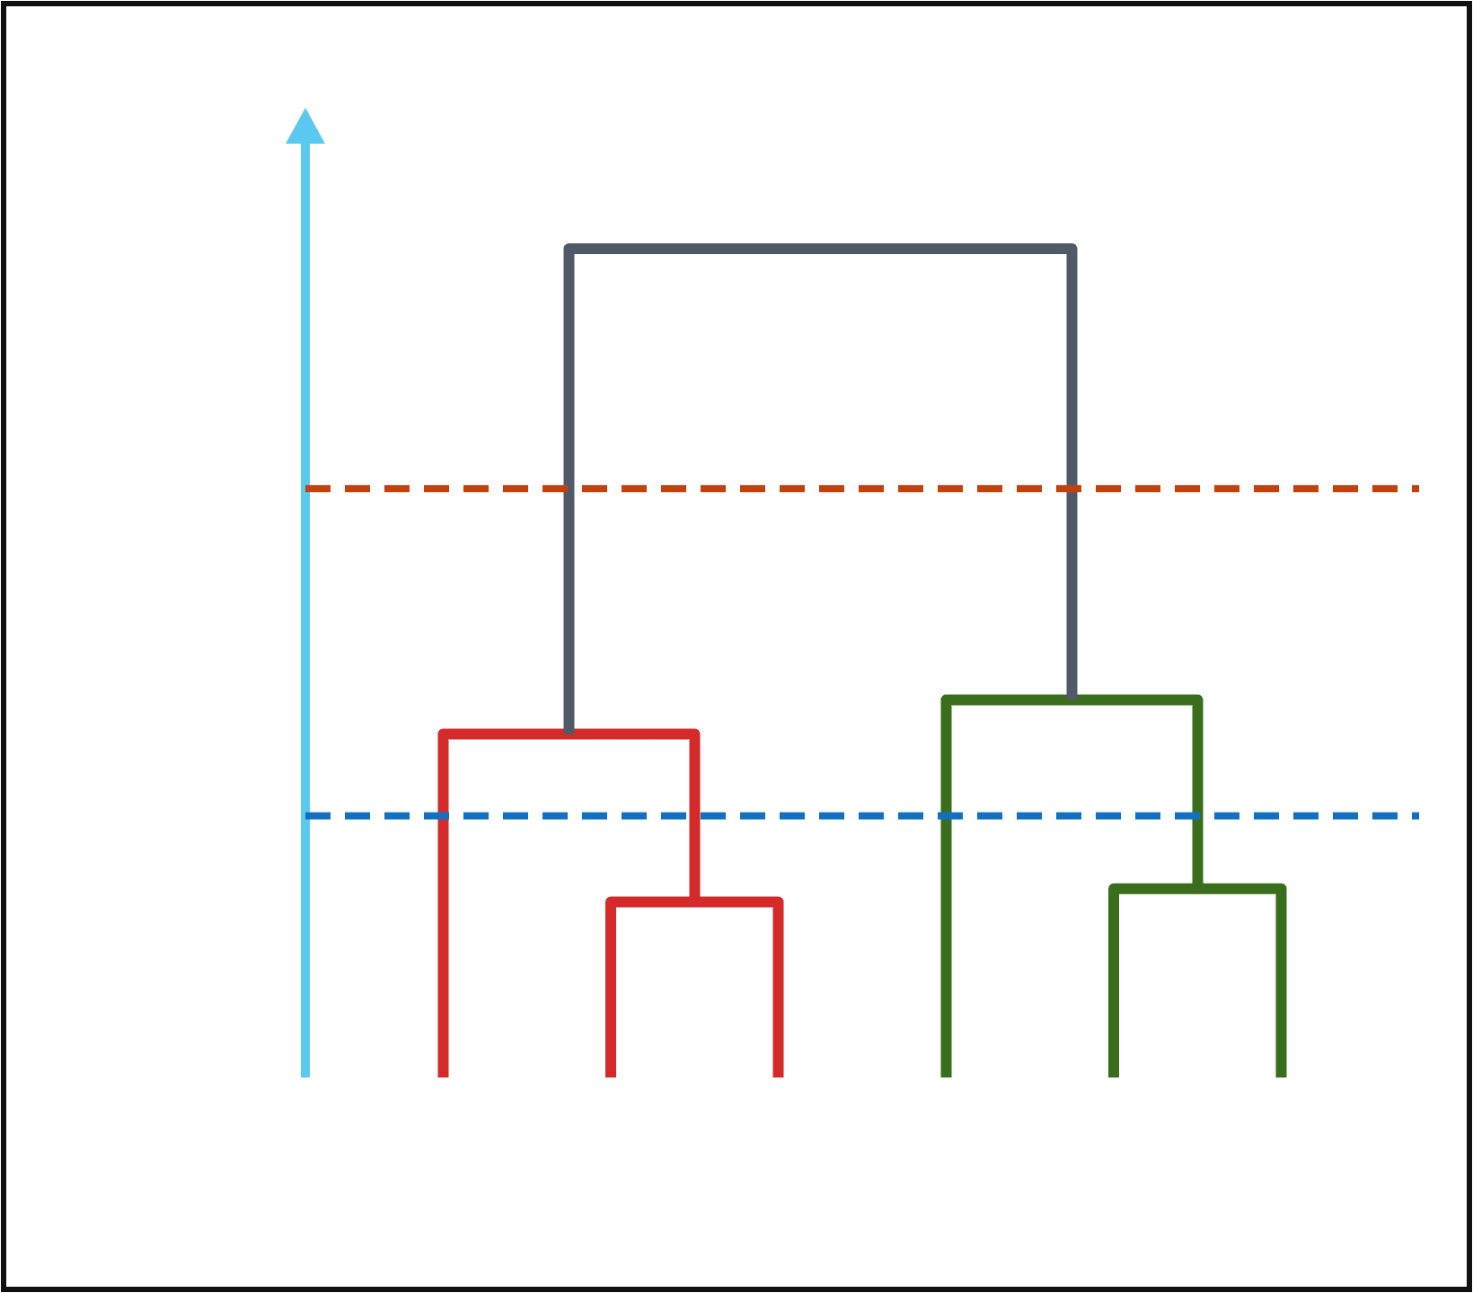
Reading a Dendrogram
Height shows how far apart two clusters were when they joined
Leaves
The bottom row: one leaf per object.
→ 2 clusters
Height
Where two branches join = the distance at which they merged.
Merge distance
→ 4 clusters
Cut
A horizontal cut gives clusters: count the branches it crosses.
C
A
B
F
D
E
Notes:
Read from the bottom. A and B join lowest, so they are the most similar pair. D and E join next. The two big groups only join at the very top, at a large distance. The orange cut crosses two vertical lines, so it gives 2 clusters: {A, B, C} and {D, E, F}. The blue cut crosses four: {A, B}, {C}, {D, E}, {F}.

Slide 6

Bottom-Up
Part 1 of 2
Agglomerative clustering
Notes:
Part one: bottom-up, agglomerative clustering.

Slide 7
The Agglomerative Algorithm
Start with n clusters, merge until one is left
1
Start
Put every object in its own cluster: n clusters.
2
Distances
Compute the distance between every pair of clusters.
3
Merge
Merge the two closest clusters into one.
4
Update
Recompute distances from the new cluster to all others.
5
Repeat
Repeat steps 3–4 until one cluster remains (or k remain).
Each merge is recorded in the dendrogram, at the height of the merge distance.
Notes:
The algorithm is simple. The only open question is step 2 and step 4: how do we measure the distance between two clusters that each contain several points? That is the linkage criterion, on the next slide.

Slide 8
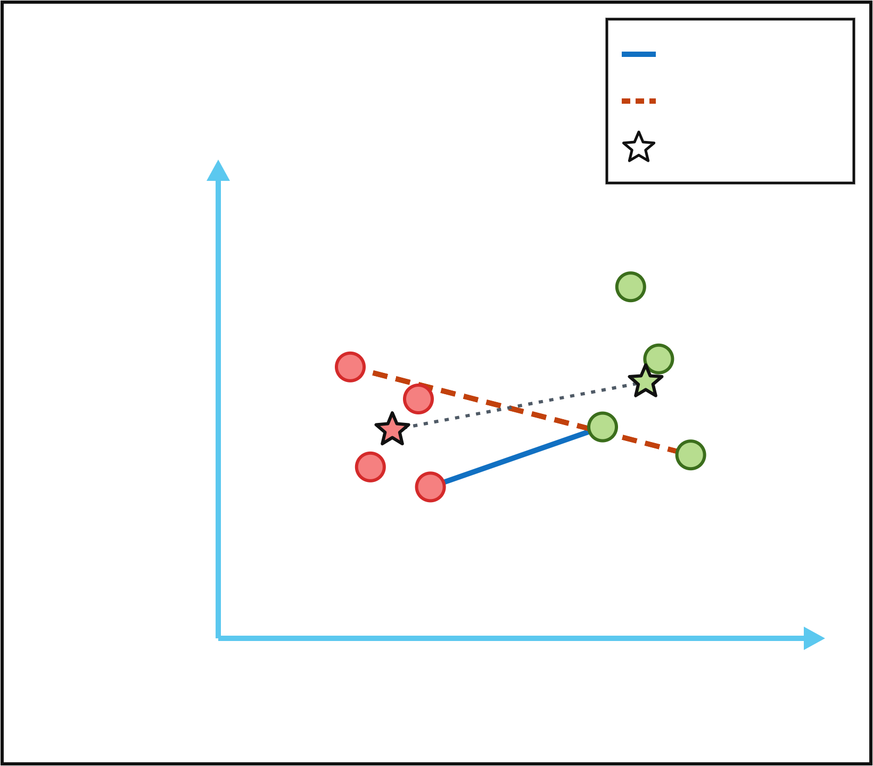
How Far Apart Are Two Clusters?
The linkage criterion defines distance between clusters
Single
Single link
Complete
Distance between the closest pair of points.
Centroid
Complete link
Distance between the farthest pair of points.
Minutes of Exercise
Average link
Average distance over all pairs of points.
Ward
Hours of Sleep
Merge the pair that least increases total SSE.
Notes:
Single link uses the closest pair: the solid blue line. Complete link uses the farthest pair: the dashed orange line. Average link averages all 16 pairs here. Centroid linkage would use the dotted line between the stars, and Ward’s method picks the merge that increases the total within-cluster SSE the least, the same objective k-means uses.

Slide 9
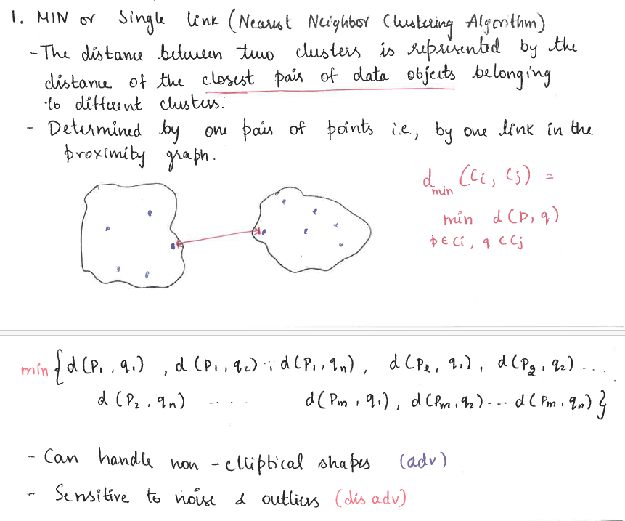

Slide 10
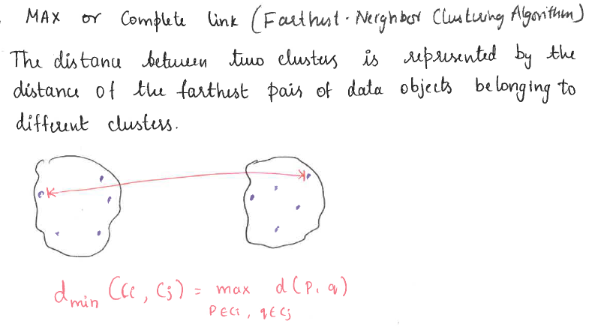
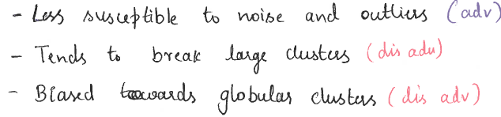

Slide 11
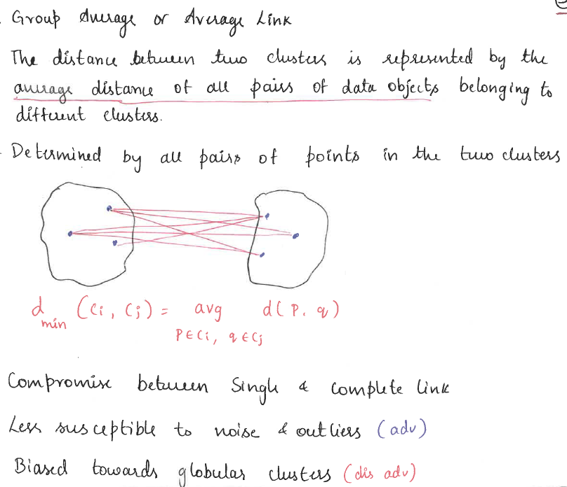

Slide 12
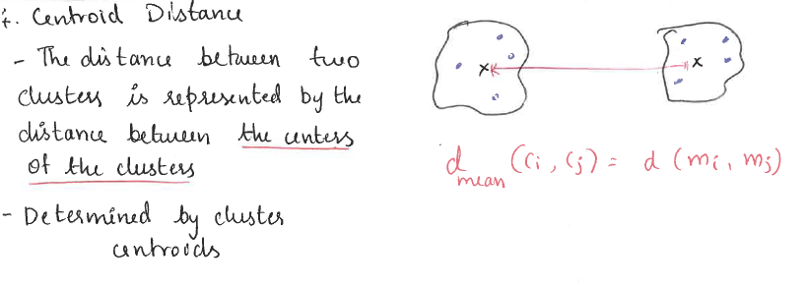

Slide 13
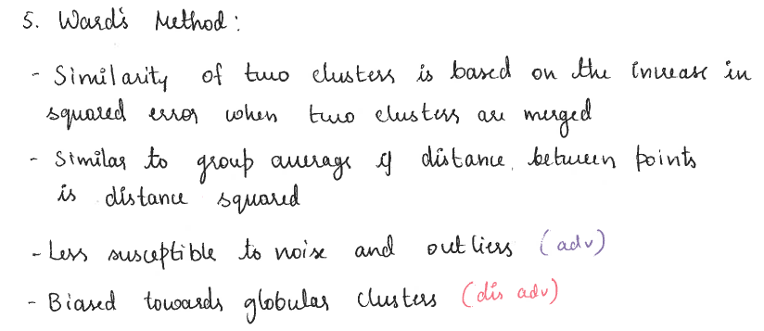

Slide 14
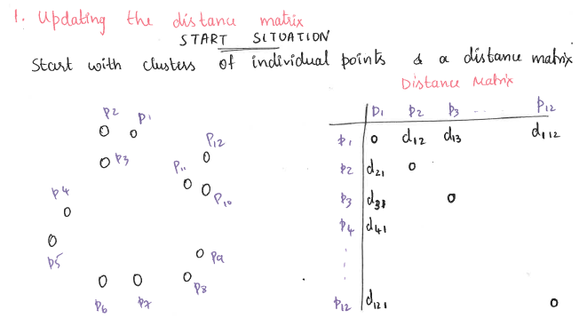
Agglomerative in Action
Notes:
Six people, labelled A to F. Nothing is merged yet, so the dendrogram has only leaves.

Slide 15
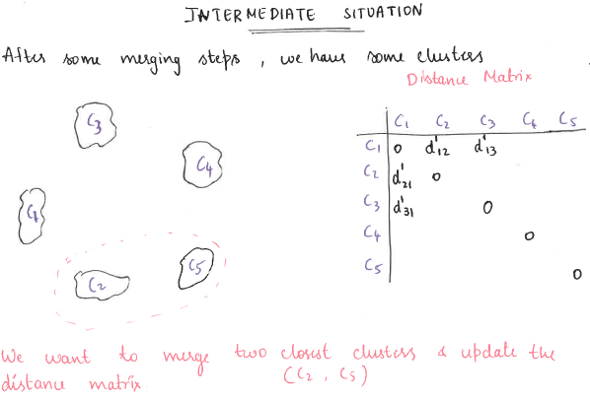
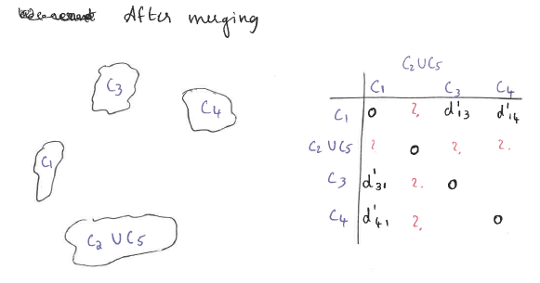
Agglomerative in Action
Notes:
Six people, labelled A to F. Nothing is merged yet, so the dendrogram has only leaves.

Slide 16
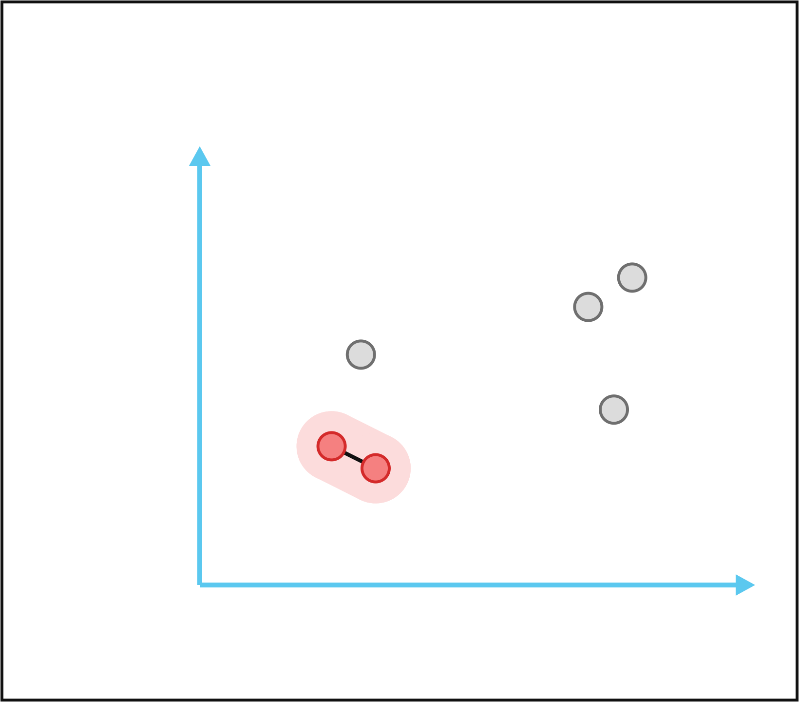
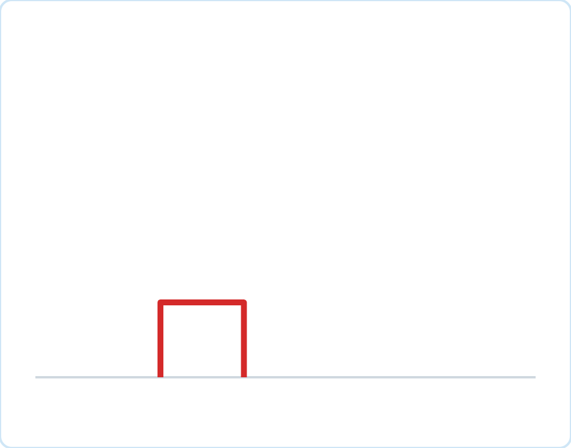
Agglomerative in Action
Six points, single link: merge the closest pair each step
MERGE 1 OF 5
A and B are the closest pair, so they merge first. 5 clusters.
E
D
C
Minutes of Exercise
F
A
B
C
A
B
F
D
E
Hours of Sleep
Notes:
The black line shows the closest pair of points. A and B merge, and the dendrogram draws their join at a low height.

Slide 17
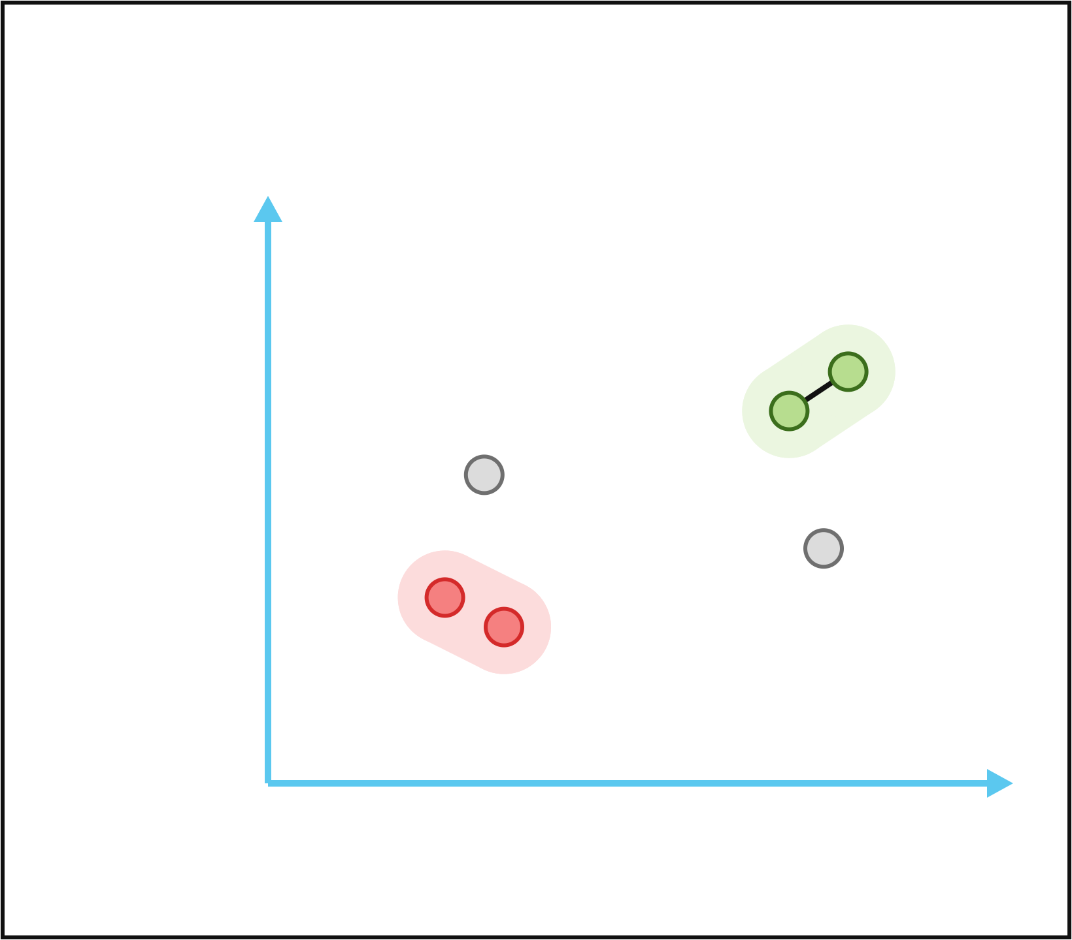
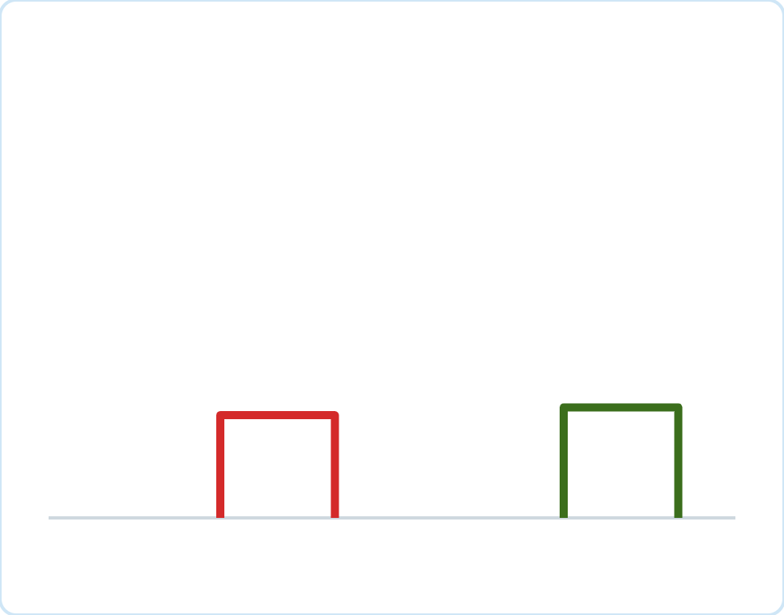
Agglomerative in Action
Six points, single link: merge the closest pair each step
MERGE 2 OF 5
D and E are the next closest pair. 4 clusters.
E
D
C
Minutes of Exercise
F
A
B
C
A
B
F
D
E
Hours of Sleep
Notes:
Next smallest distance: D and E. Another low join in the tree.

Slide 18
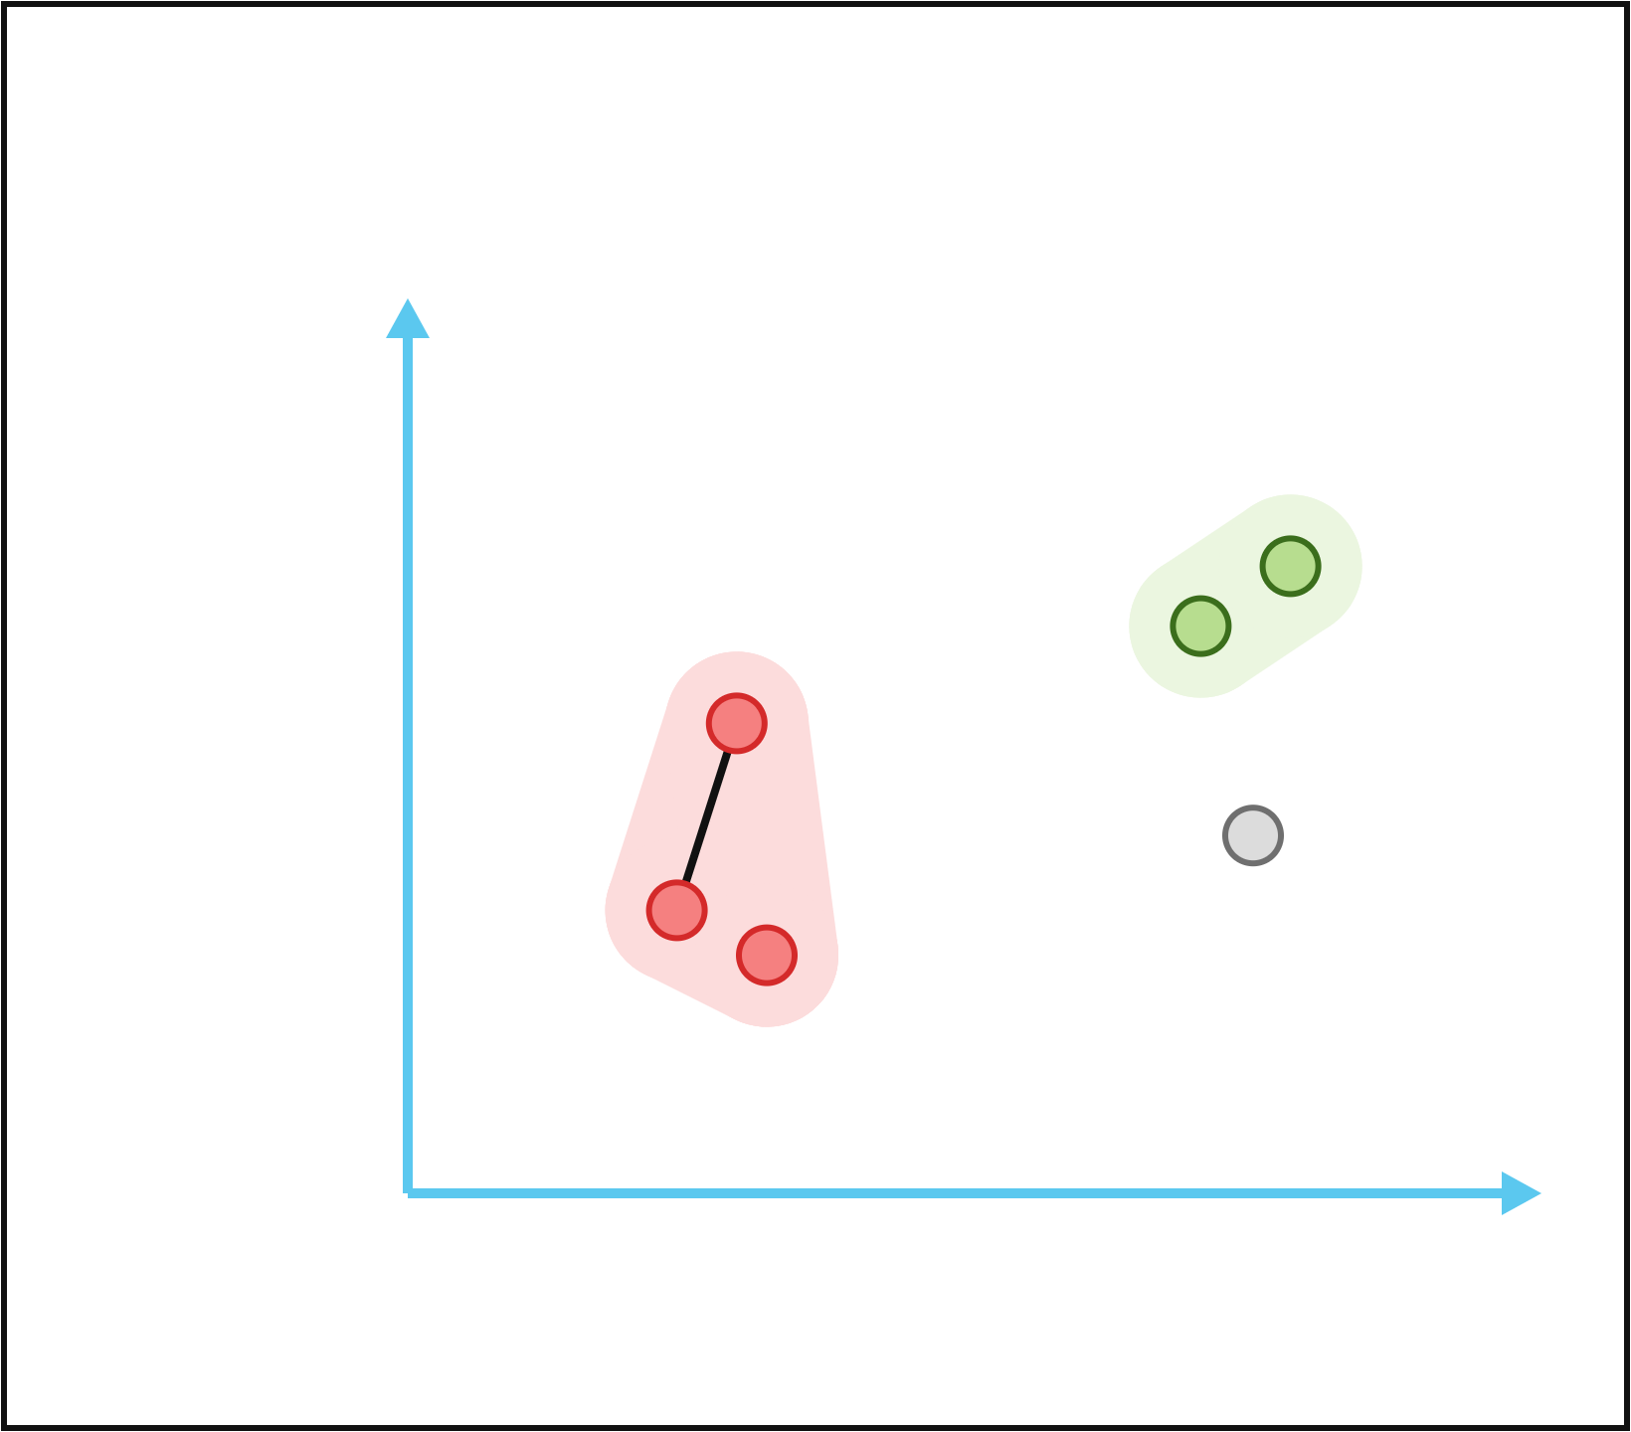
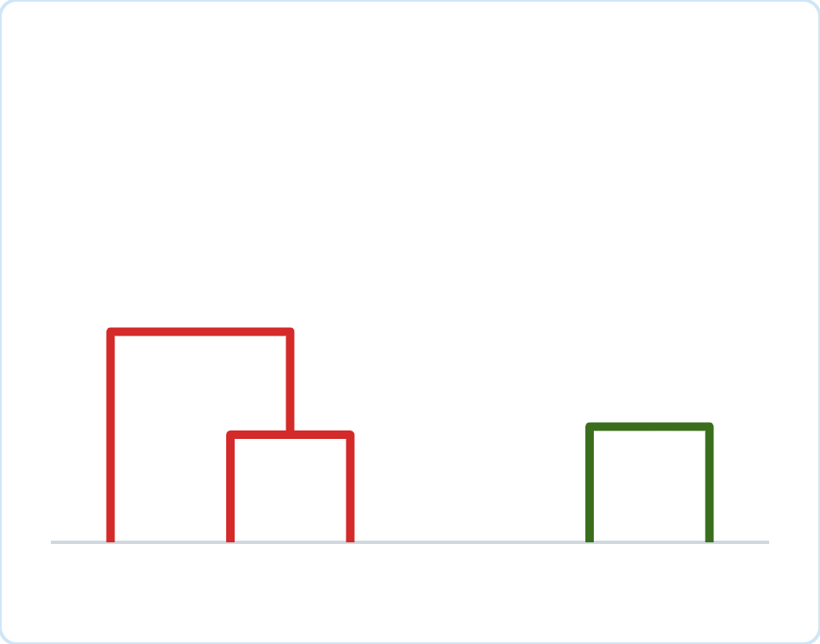
Agglomerative in Action
Six points, single link: merge the closest pair each step
MERGE 3 OF 5
C is closest to {A, B}: its nearest member B is closer than any other pair. 3 clusters.
E
D
C
Minutes of Exercise
F
A
B
C
A
B
F
D
E
Hours of Sleep
Notes:
With single link, the distance from C to the cluster {A, B} is C’s distance to its nearest member. That beats every other pair, so C joins.

Slide 19
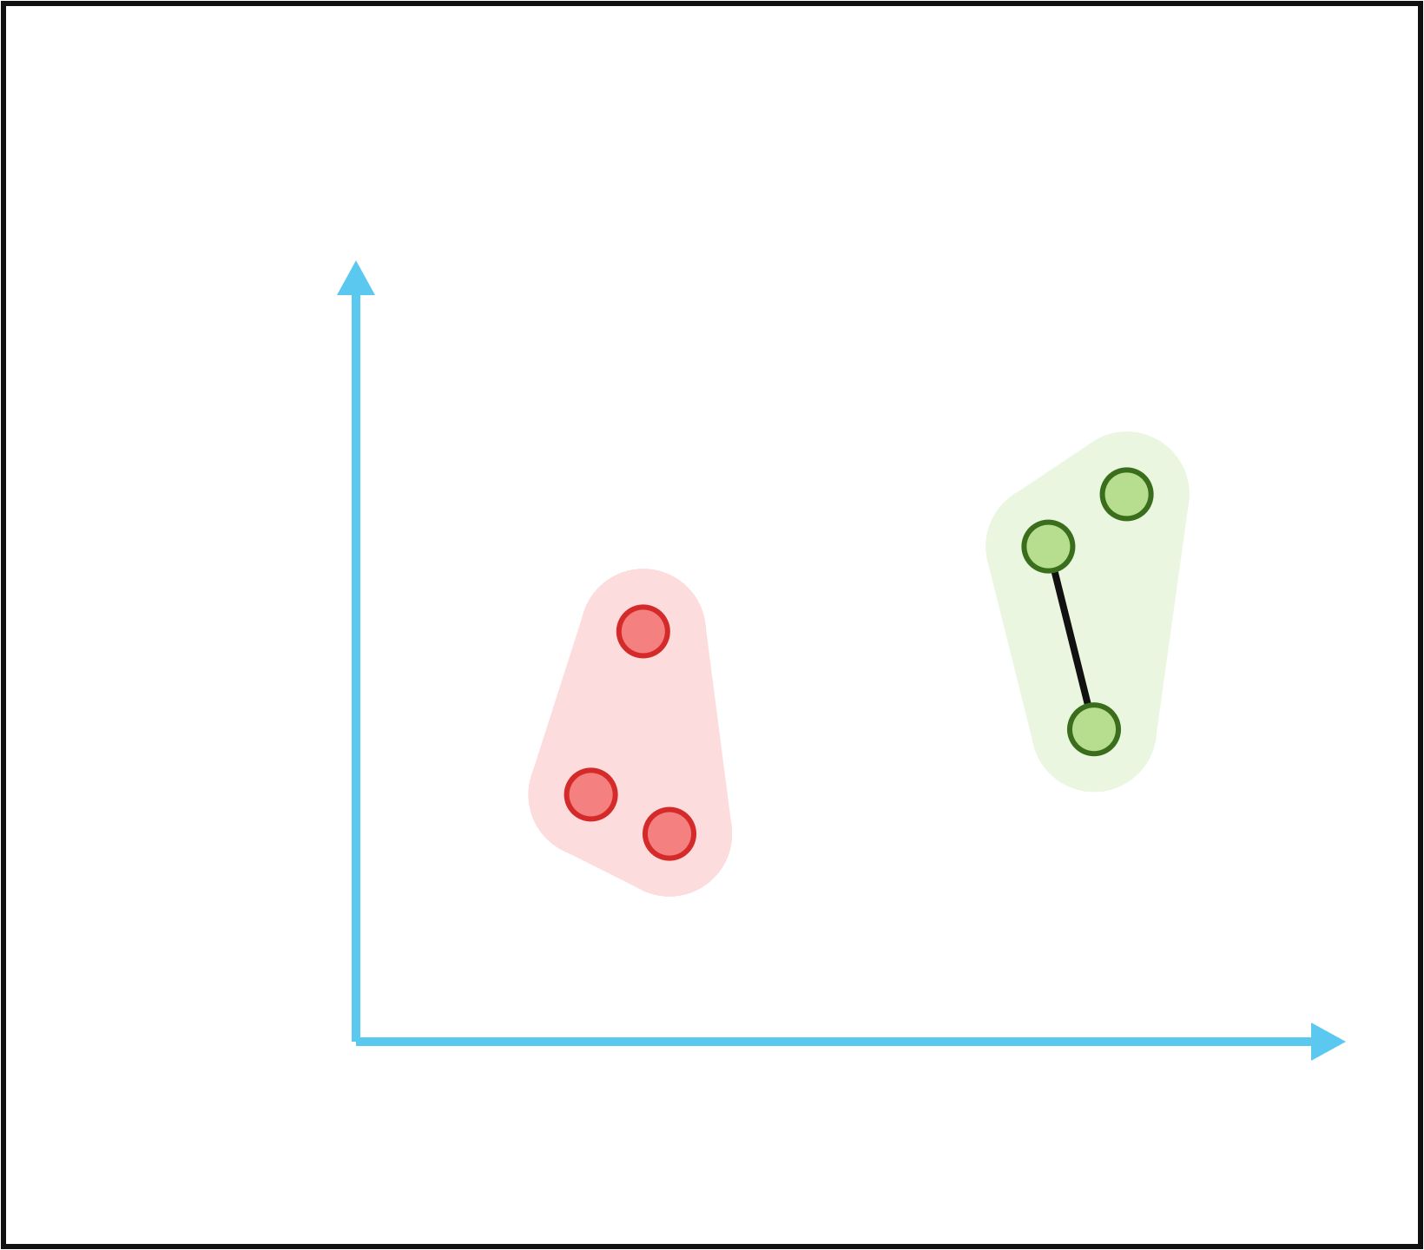
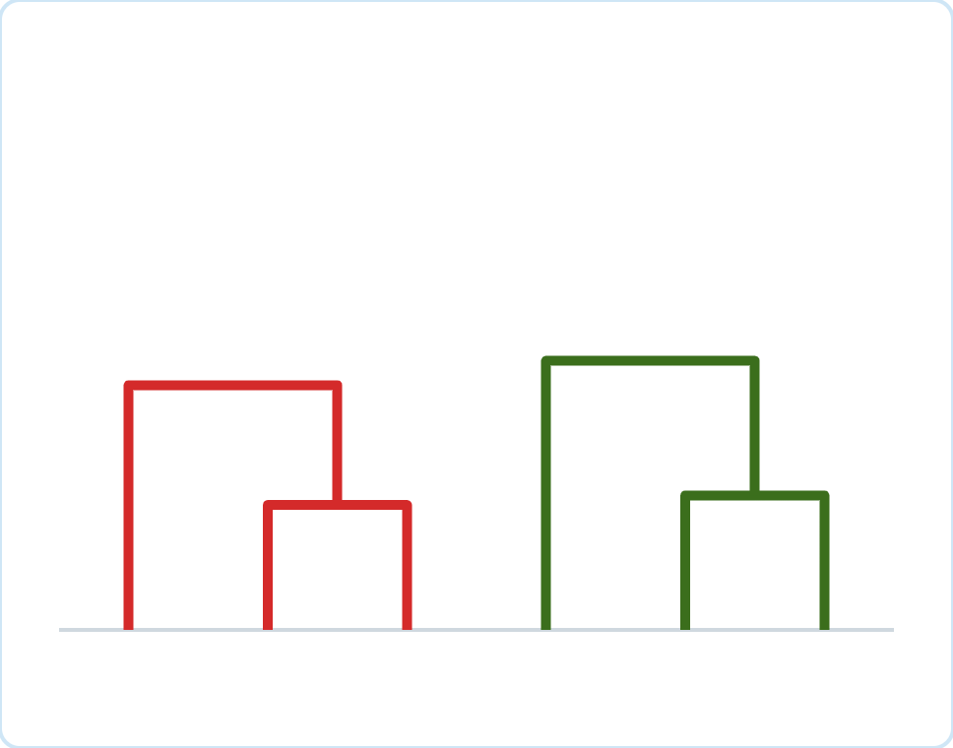
Agglomerative in Action
Six points, single link: merge the closest pair each step
MERGE 4 OF 5
F joins {D, E} the same way. 2 clusters.
E
D
C
Minutes of Exercise
F
A
B
C
A
B
F
D
E
Hours of Sleep
Notes:
F joins {D, E} by the same rule.

Slide 20
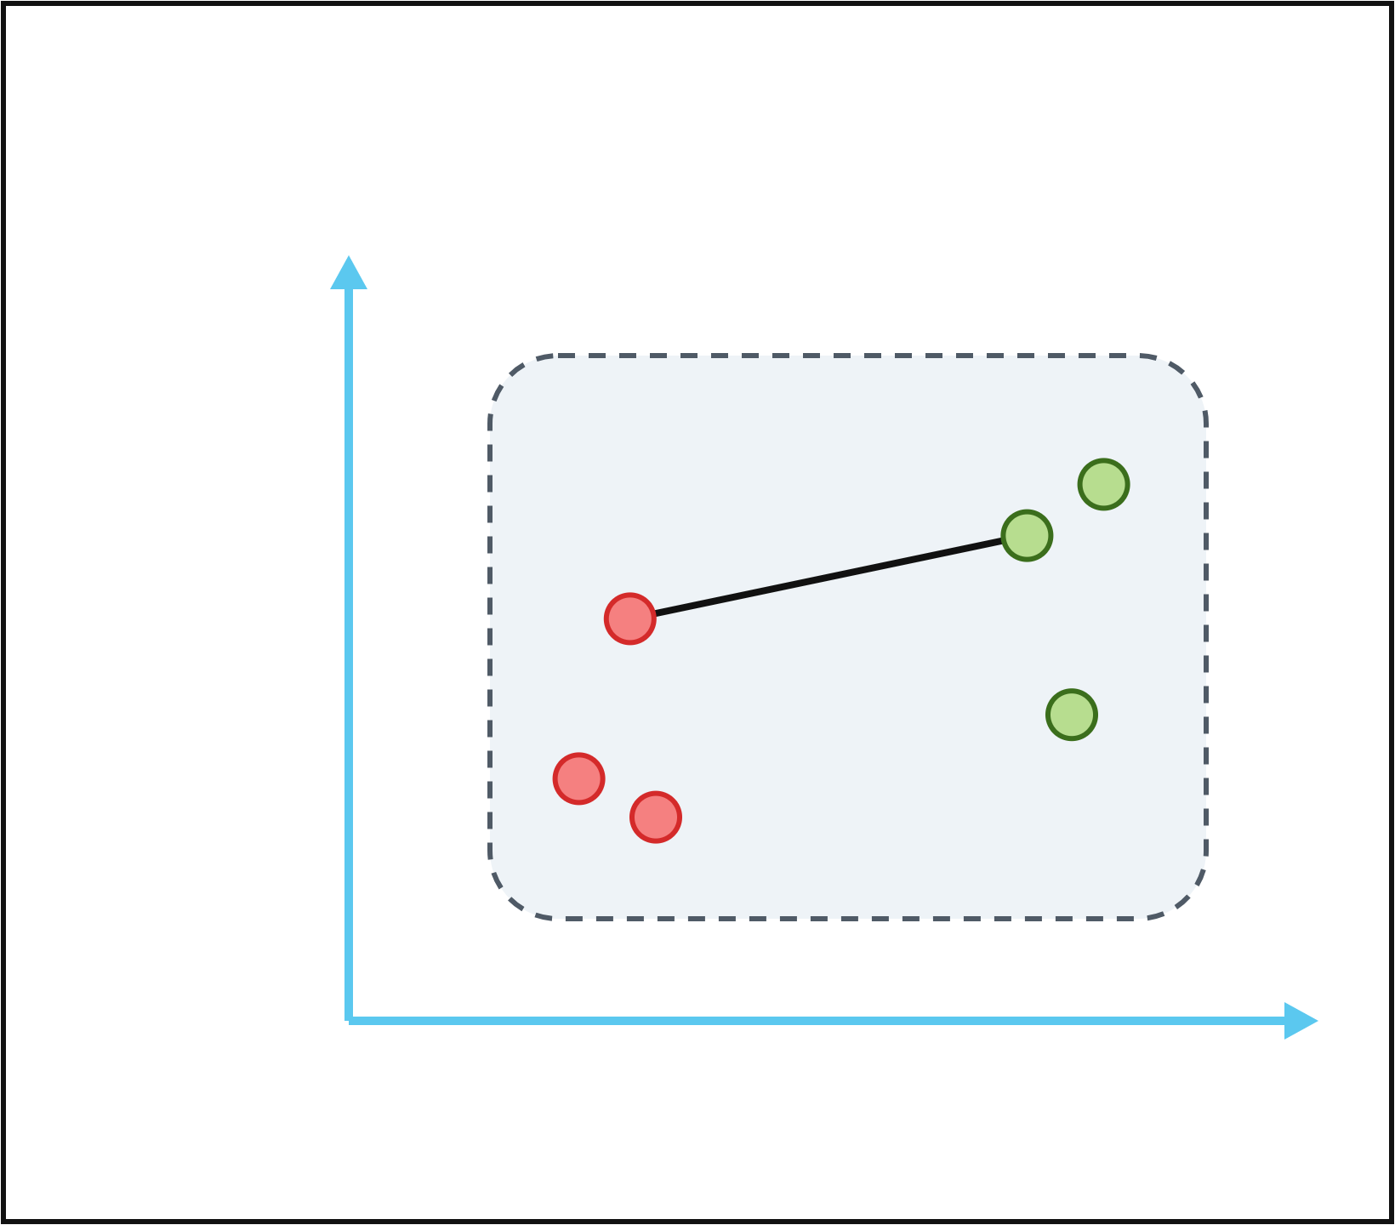
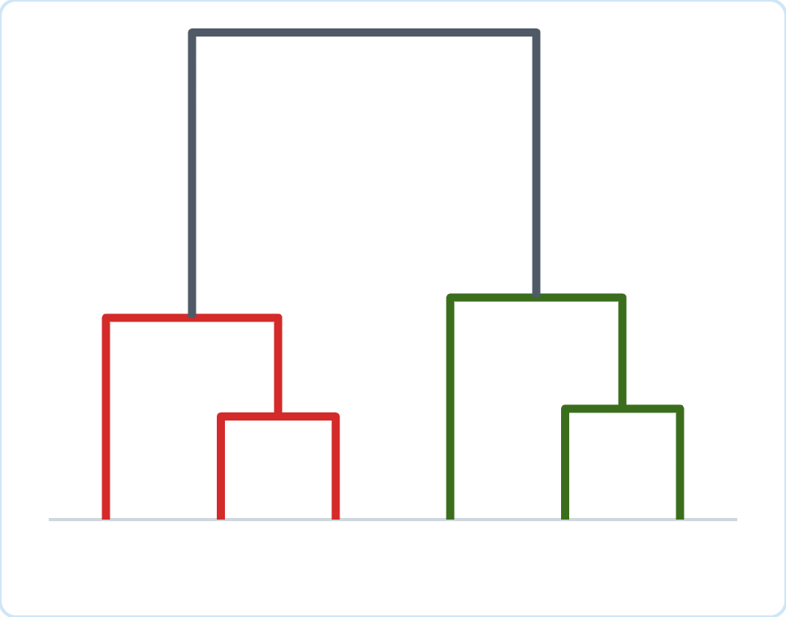
Agglomerative in Action
Six points, single link: merge the closest pair each step
MERGE 5 OF 5
The two remaining clusters merge at a large distance. 1 cluster; the tree is complete.
E
D
C
Minutes of Exercise
F
A
B
C
A
B
F
D
E
Hours of Sleep
Notes:
Finally the two groups merge. The join is high because the closest pair between the groups is far apart. Notice the big gap in the dendrogram: a clear sign of two natural clusters.

Slide 21
Agglomerative: Strengths and Weaknesses
Rich structure, but costly for large data
Strengths
Weaknesses
No need to choose k in advance
Dendrogram shows structure at every level
Works with any distance and many linkages
Deterministic: same data, same tree
Merges are final: early mistakes cannot be undone
Needs the n × n distance matrix: O(n²) memory, at least O(n²) time
Single link chains; outliers can distort the tree
Result depends on the linkage chosen
Notes:
The big practical limit is size: storing all pairwise distances for 100,000 objects means about 5 billion numbers. For large data, top-down approaches or sampling are more practical, which leads us to part two.

Slide 22
Top-Down
Part 2 of 2
Divisive clustering with recursive k-means
Notes:
Part two: top-down, divisive clustering, using k-means with k = 2 to make each split.

Slide 23
Divisive Clustering: The Idea
Start with everything together, then split
Ways to split just 32 objects into two non-empty groups:
Use k-means, k = 2
Let 2-means find a good split quickly, then split the halves the same way.
2,147,483,647
In general 2ⁿ⁻¹ − 1. Trying every split is hopeless.
Recursive k-means
Also called bisecting k-means (Steinbach, Karypis & Kumar, 2000).
In practice
Available as BisectingKMeans in scikit-learn.
Notes:
Divisive clustering starts with all objects in one cluster and splits. The hard part is choosing the split: the number of possible two-way splits doubles with every object added. The trick is to hand that job to k-means with k = 2, which we already know is fast. Applying it again and again to the pieces gives recursive, or bisecting, k-means.

Slide 24
Recursive (Bisecting) k-Means
Split one cluster at a time with 2-means
1
Start
Put all objects in one cluster.
2
Choose
Pick the cluster to split: the one with the largest SSE.
3
Bisect
Split it with k-means, k = 2. Try several starts; keep the lowest SSE.
4
Replace
Replace the cluster with its two halves.
5
Repeat
Repeat steps 2–4 until there are k clusters.
Alternatives: split the largest cluster, or stop when every cluster is small or tight enough.
Notes:
Step 2 is a choice. Splitting the cluster with the largest SSE targets the loosest cluster; splitting the largest cluster gives more balanced sizes. scikit-learn offers both. Because each split only runs 2-means on one cluster, each step is cheap.

Slide 25
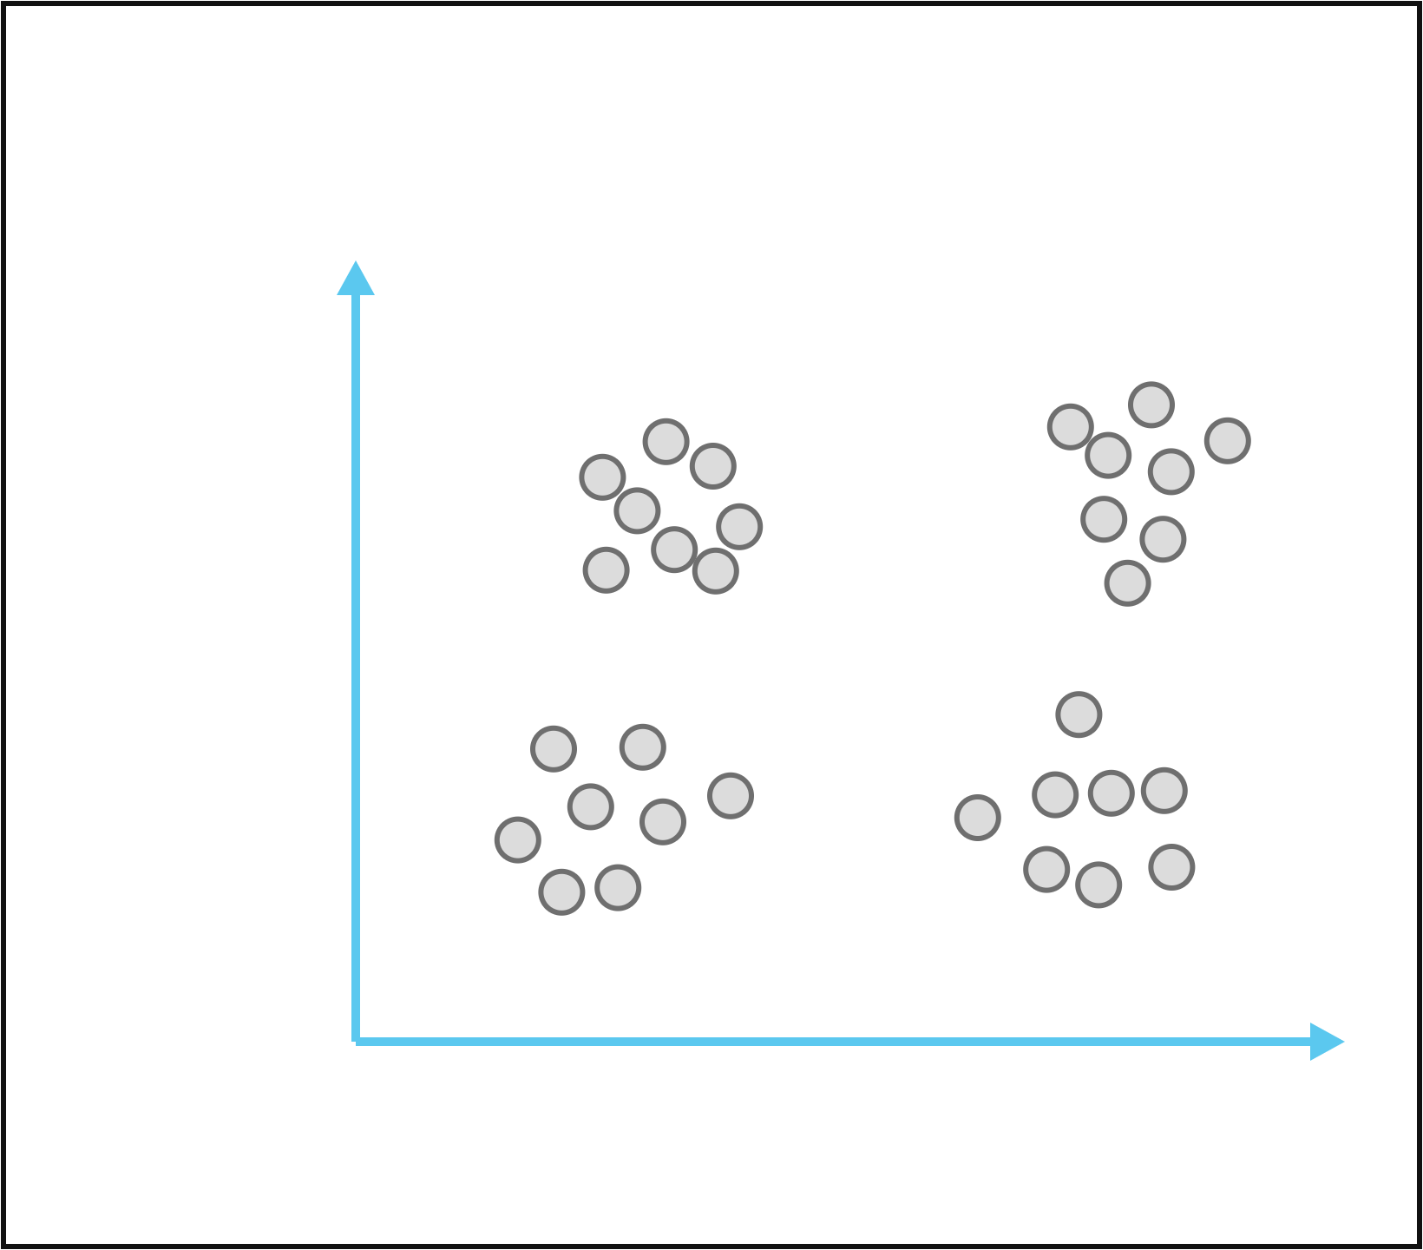
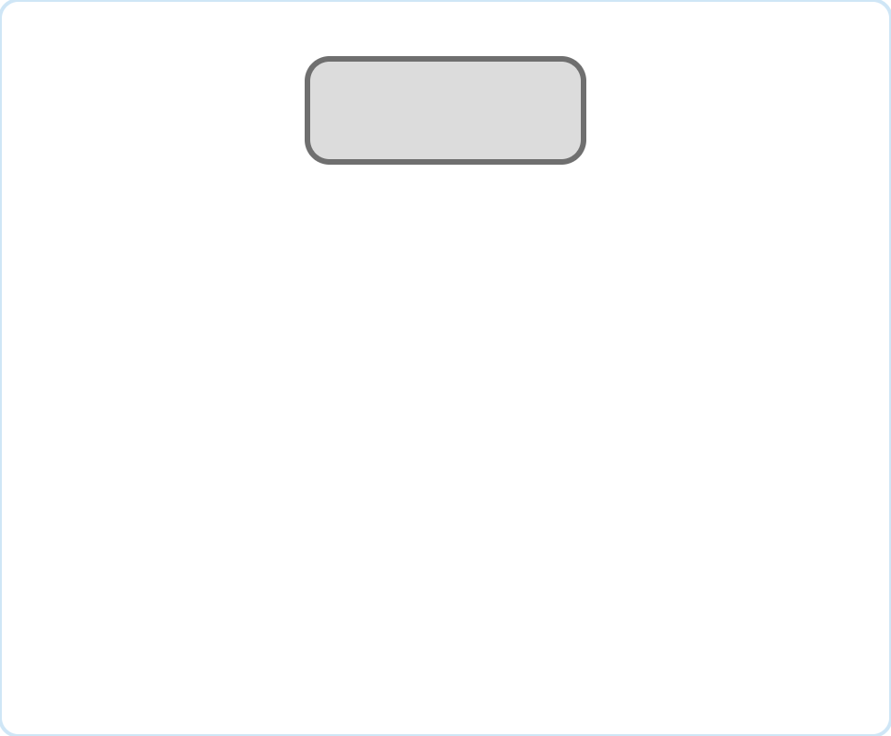
Recursive k-Means in Action
Splitting 32 people into 4 groups, one 2-means split at a time
START
All 32 people are in one cluster.
All · 32
Minutes of Exercise
Hours of Sleep
Notes:
We start at the root of the tree: one cluster with everyone.

Slide 26
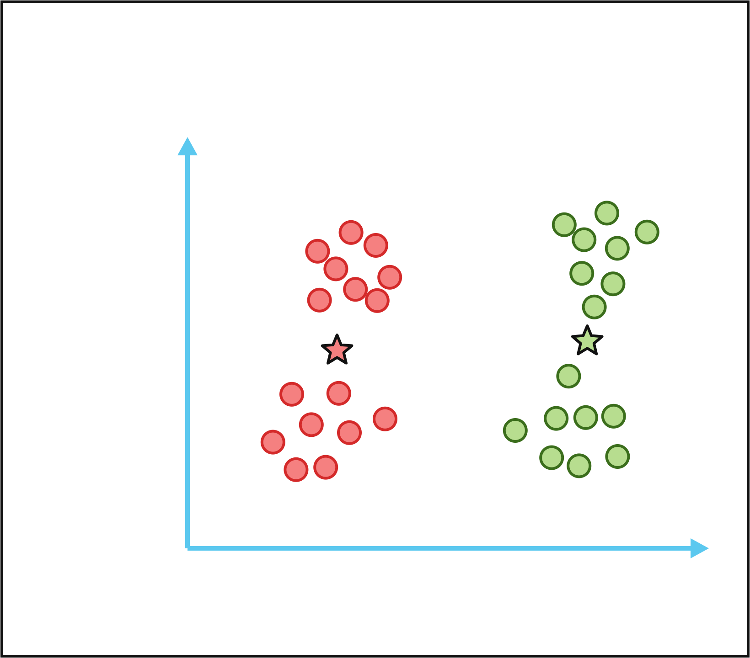
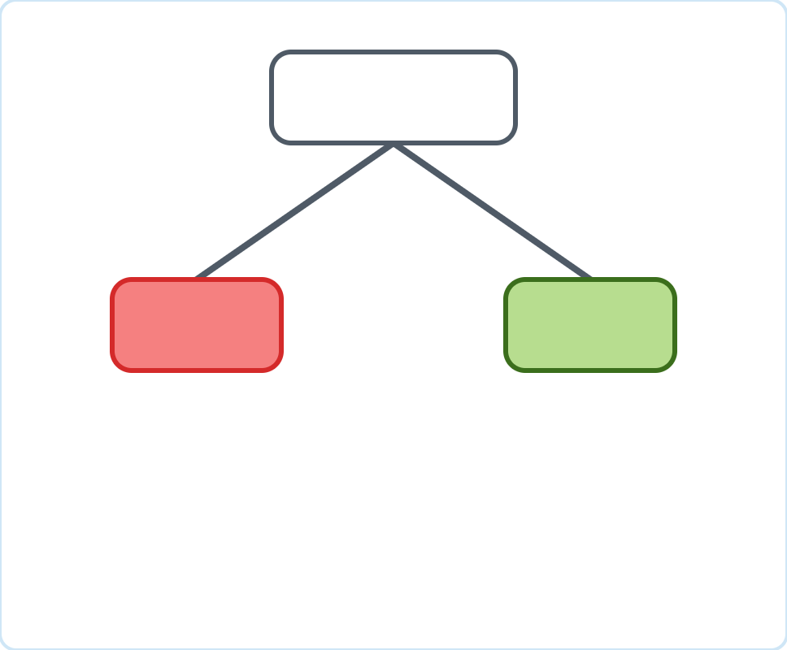
Recursive k-Means in Action
Splitting 32 people into 4 groups, one 2-means split at a time
SPLIT 1 OF 3
2-means on everyone: less sleep (left) vs more sleep (right).
All · 32
Minutes of Exercise
16
16
Hours of Sleep
Notes:
Run ordinary k-means with k = 2 on all 32 points. The stars are the two centroids. The biggest difference in this data is sleep, so that is the first split.

Slide 27
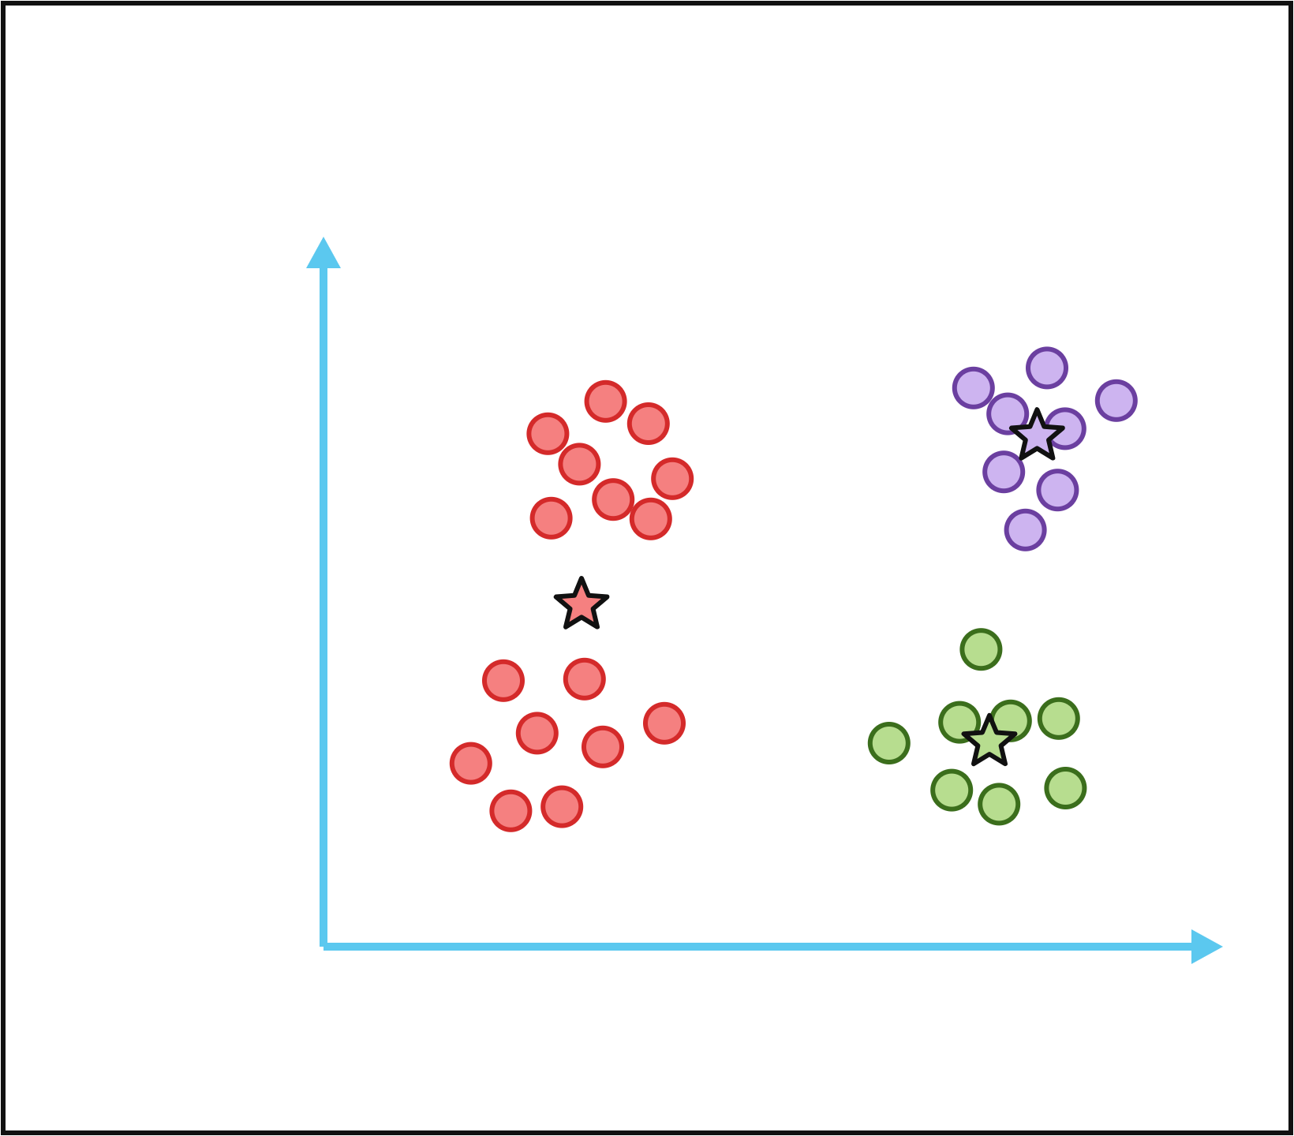
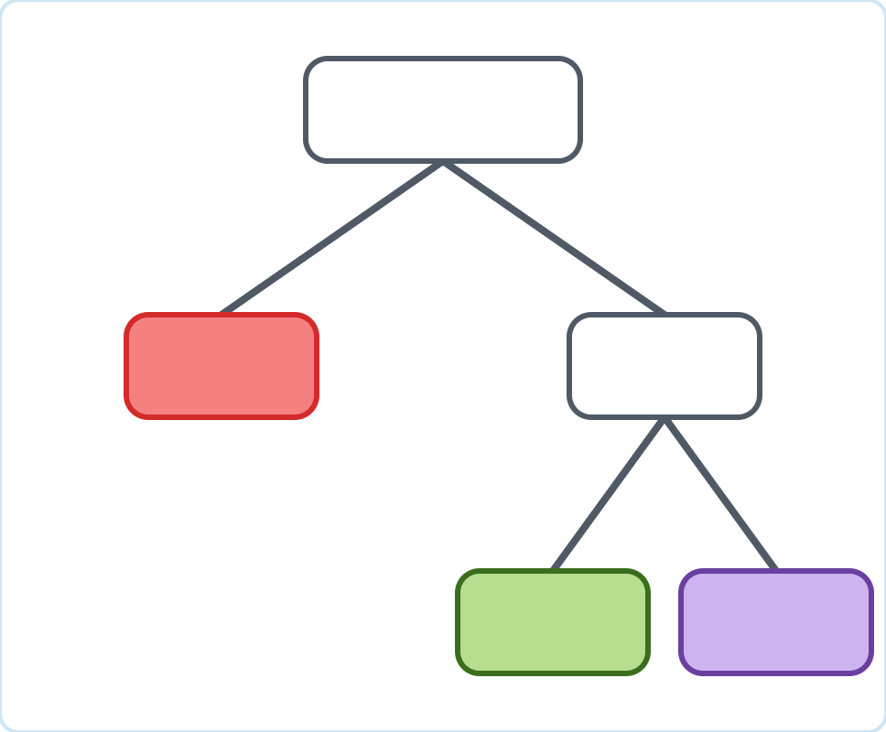
Recursive k-Means in Action
Splitting 32 people into 4 groups, one 2-means split at a time
SPLIT 2 OF 3
The right cluster has the larger SSE (1.31 vs 1.11), so split it next: more vs less exercise.
All · 32
Minutes of Exercise
16
16
8
8
Hours of Sleep
Notes:
Which cluster next? We compute each cluster’s SSE. The right one is looser, 1.31 versus 1.11, so we bisect it with 2-means.

Slide 28
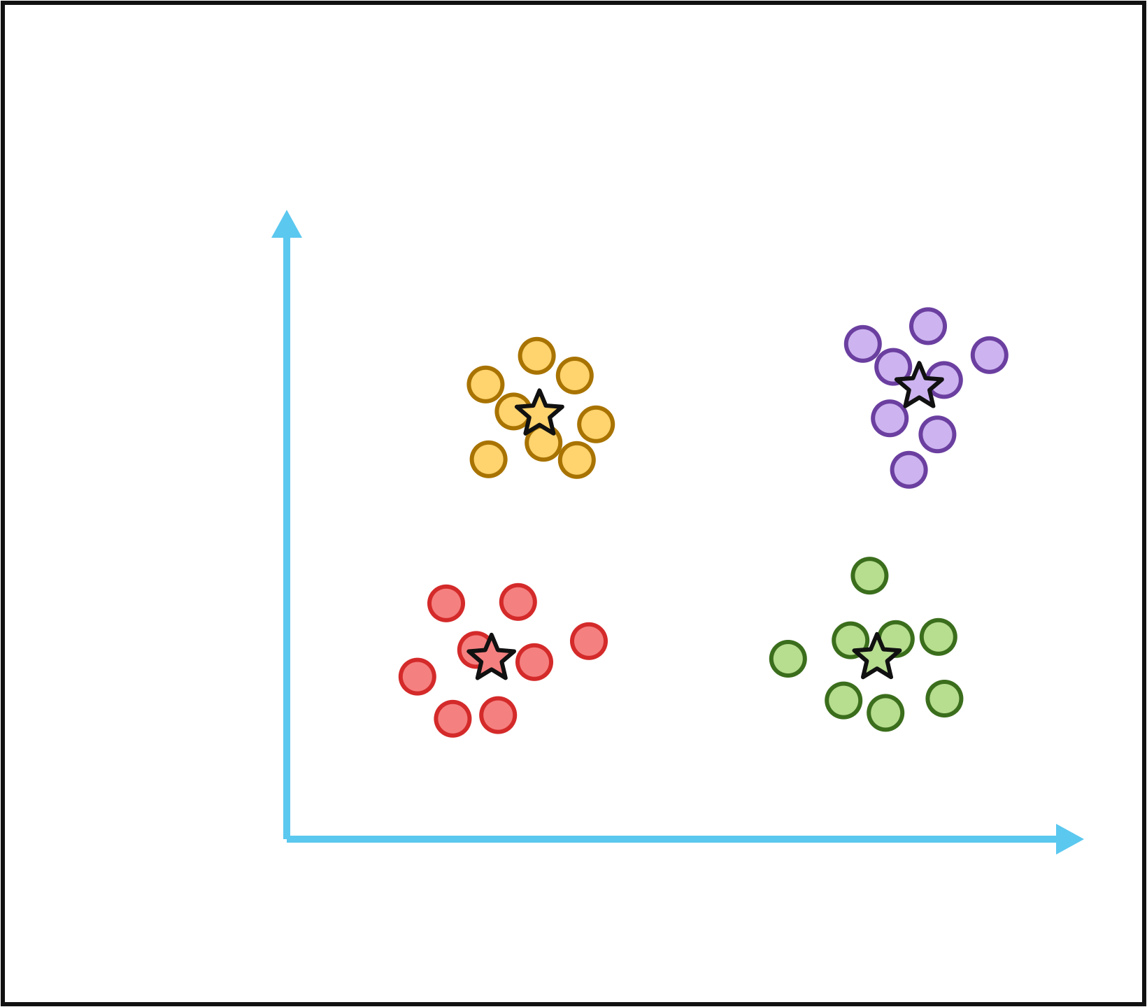
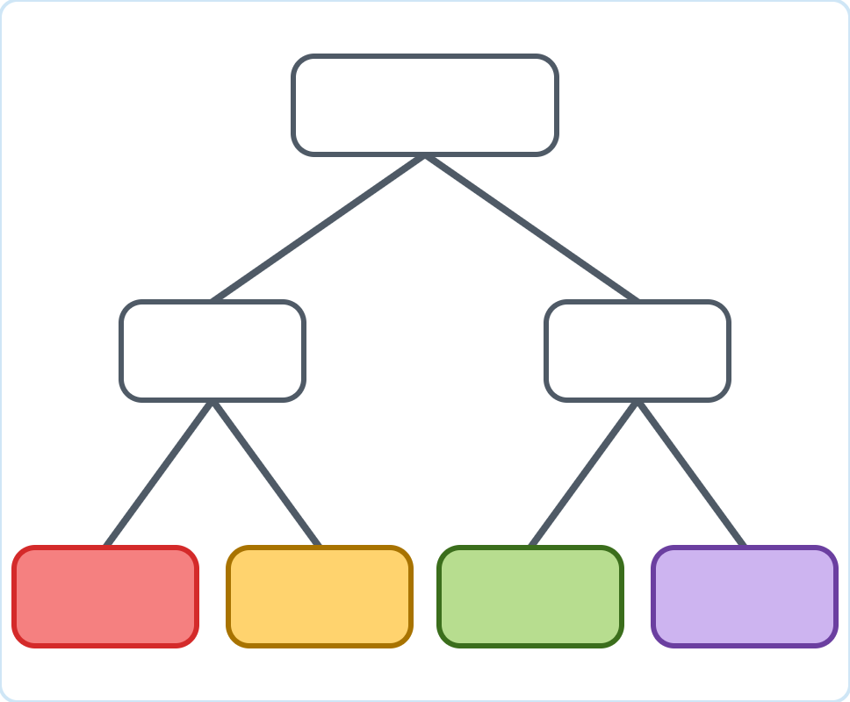
Recursive k-Means in Action
Splitting 32 people into 4 groups, one 2-means split at a time
SPLIT 3 OF 3
Now the left cluster has the largest SSE, so split it too. 4 clusters: stop here, or keep splitting.
All · 32
Minutes of Exercise
16
16
8
8
8
8
Hours of Sleep
Notes:
The left cluster is now the loosest, so it is split. We asked for 4 clusters, so we stop. The tree on the right is the top of a dendrogram built from the top down.

Slide 29
Recursive k-Means: Strengths and Weaknesses
Scales well, but every split inherits k-means’ limits
Strengths
Weaknesses
Fast: each step is one 2-means run, so it scales to large data
Sees global structure first: top splits use all the data
Stop as soon as you have enough clusters
Tends to give more evenly sized clusters
Splits are final: a bad early split cannot be undone
Inherits k-means limits: numeric data, round clusters
Each split depends on random starts
Needs rules for which cluster to split and when to stop
Notes:
Recursive k-means is a practical way to get a hierarchy for large data, because it never needs the full distance matrix. It has been used widely for document clustering. But it carries the weaknesses of k-means into every split.

Slide 30
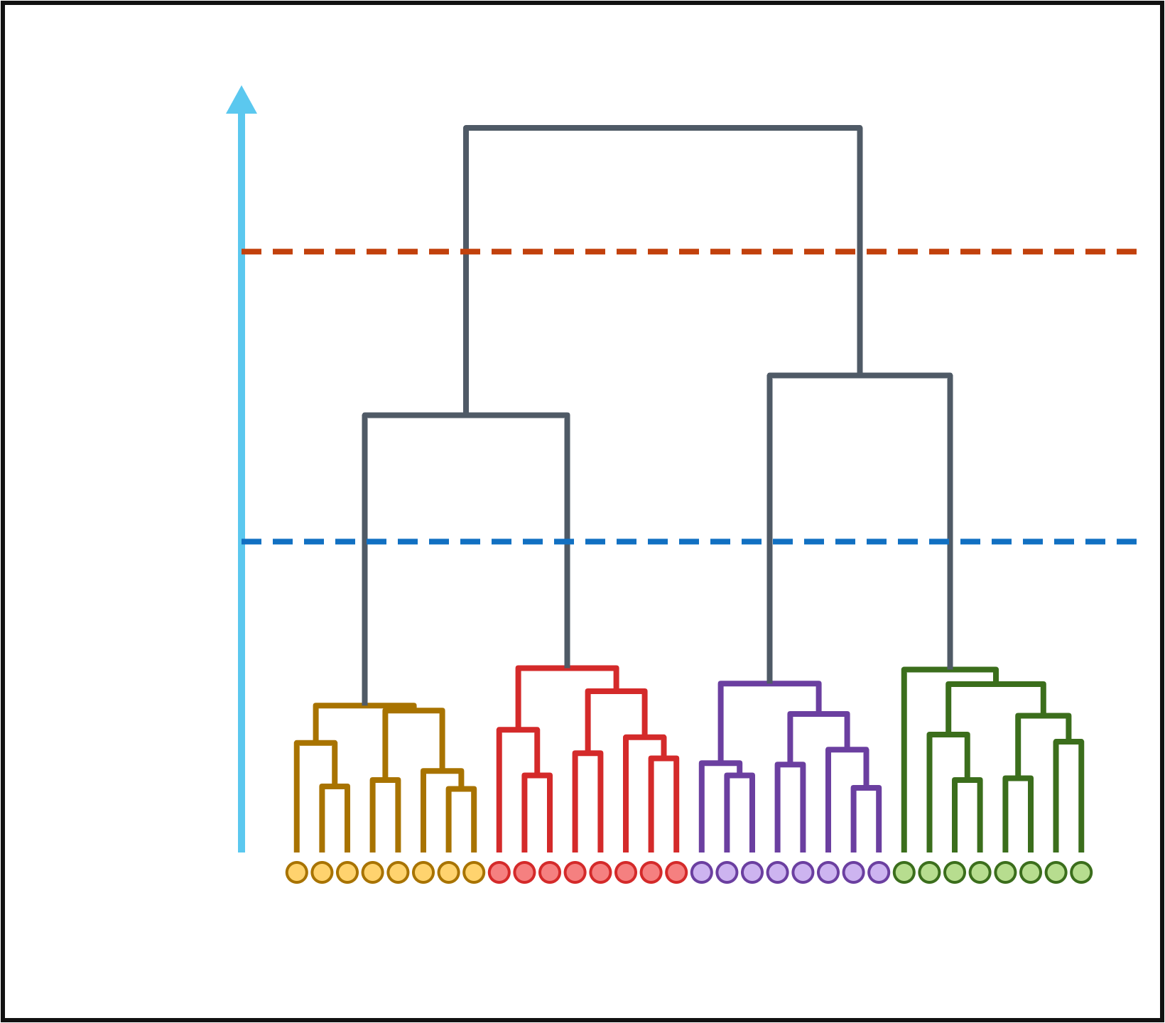
Choosing the Number of Clusters
Cut the dendrogram where the branches are long
Cut the tree
A horizontal cut gives a flat clustering with as many clusters as branches crossed.
→ 2 clusters
Where to cut
Merge distance
Cut across a long stretch with no merges: those merges join very different groups.
→ 4 clusters
Nested
The 4 clusters split the 2 clusters, with no need to re-run.
32 people (average link)
Notes:
This is the agglomerative tree for the 32 people from the recursive k-means example, using average link. Long vertical stretches with no merges mean the groups below are well separated. Cutting there gives 2 clusters (sleep) or 4 clusters (sleep and exercise), the same four groups recursive k-means found from the top.

Slide 31
Side-by-Side Comparison
Bottom-up agglomerative vs top-down recursive k-means
 | Agglomerative | Recursive k-means
Direction | Bottom-up | Top-down
Starts with | n single-object clusters | One cluster with all objects
Each step | Merge the two closest clusters | Split one cluster with 2-means
Key choice | Linkage: single, complete, average, Ward | Which cluster to split; when to stop
Data | Any distance matrix | Numeric (needs means)
Cost | O(n²) memory, at least O(n²) time | One 2-means run per split: scales well
Undo? | No: merges are final | No: splits are final
Strongest at | Small data, fine local detail | Large data, big top-level groups
Notes:
Both build a hierarchy and neither can undo a step. Agglomerative is more flexible about distances and shows fine detail at the bottom of the tree; recursive k-means is faster and focuses on the big splits at the top.

Slide 32
Key Takeaways
Two directions, one tree
1
Hierarchy
2
Bottom-up
3
Top-down
A tree of nested clusters. Cut the dendrogram to choose the number of clusters.
Agglomerative: merge the two closest clusters. Linkage matters; costs O(n²).
Recursive k-means: split the loosest cluster with 2-means. Fast, k-means limits.
Both directions build a dendrogram; neither can undo a step. Choose by data size and by which levels of the tree matter most.
Notes:
Recap. If time allows, ask: you have 2 million customer records and want 5 segments; which direction would you use? Recursive k-means, because agglomerative would need a 2 million by 2 million distance matrix.

